Slide 1

E.D.’s Report
Executive Director Kevin Delahoussaye
December 2025
Notes:
LHC has finished another successful year filled with much progress. Today I am going to recap a few of those highlights from December. I am looking forward to what we will do in the new year together.

Slide 2
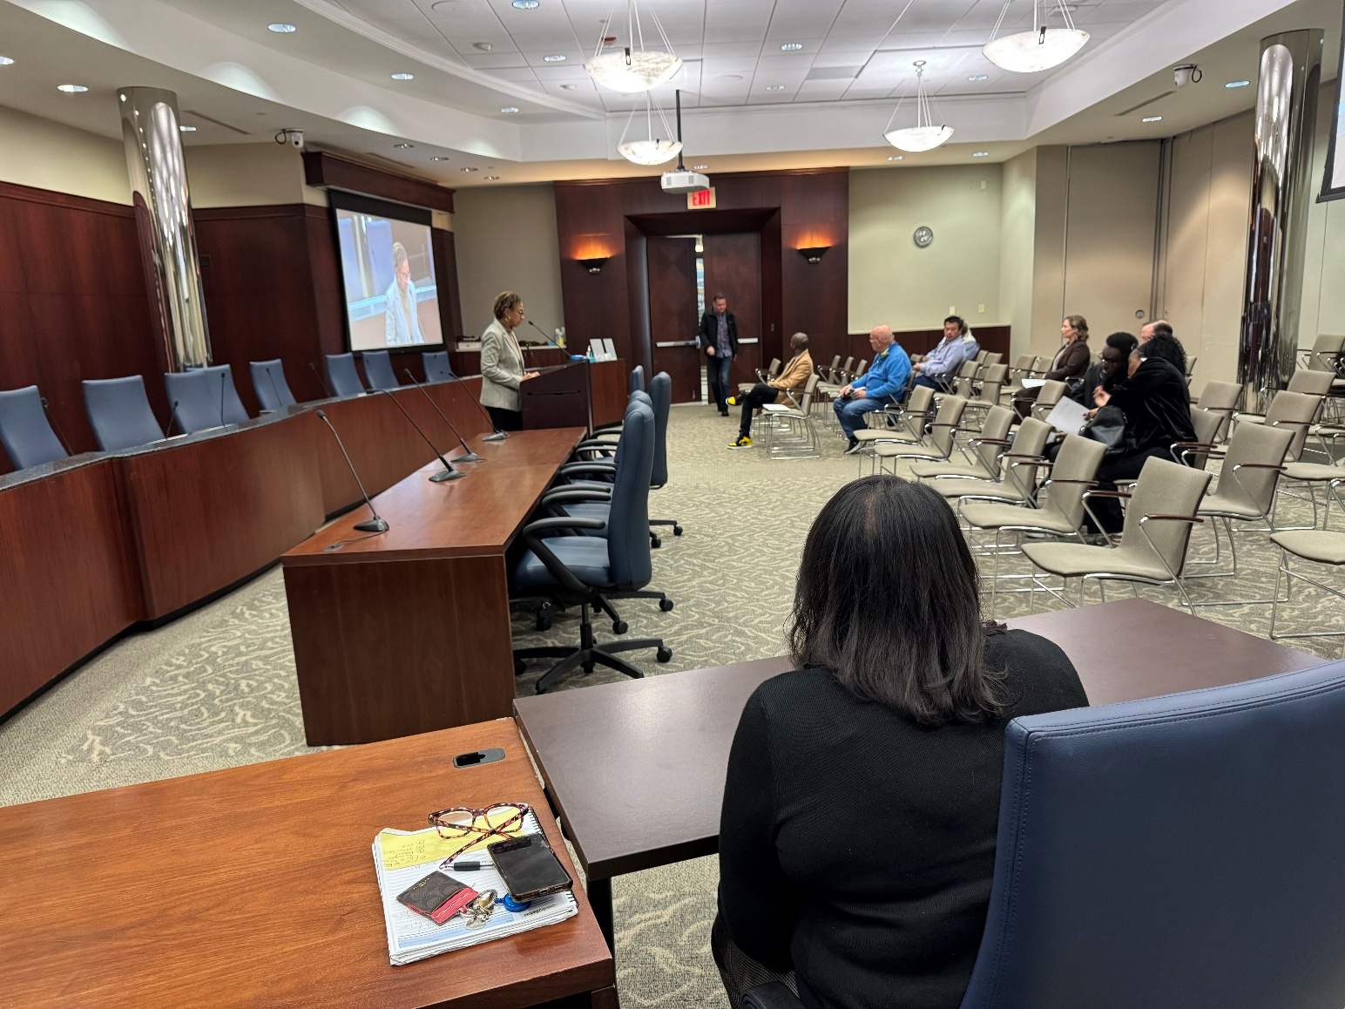
QAP Public Hearing & Developer’s Forum
Notes:
LHC held a public hearing and a developer's forum for PRIME-4 at LHC Headquarters. We appreciate those who came out to this meeting.

Slide 3
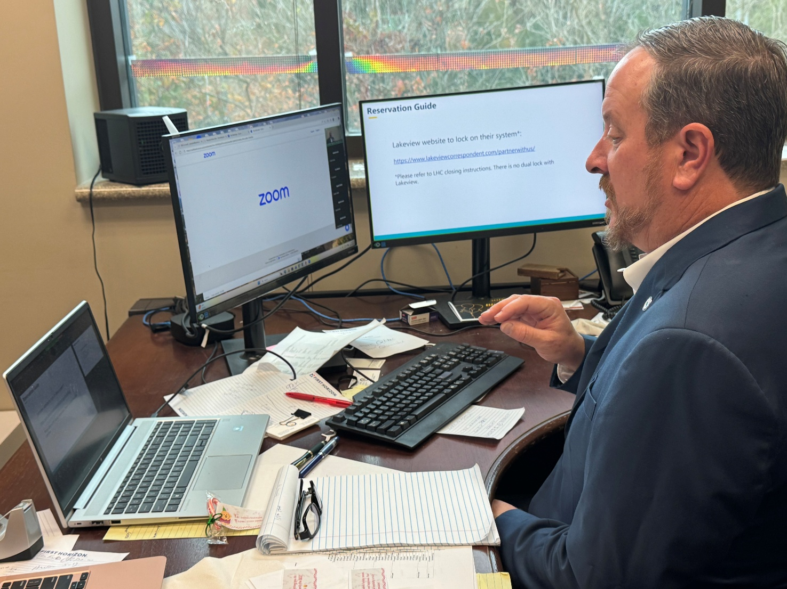
LHC Loan Officer Training Courses
Notes:
The Homeownership Department continued holding virtual loan officer training courses. We have achieved significant success in attendance, enabling us to educate LHC Certified Loan Officers on LHC Homeownership Programs.

Slide 4

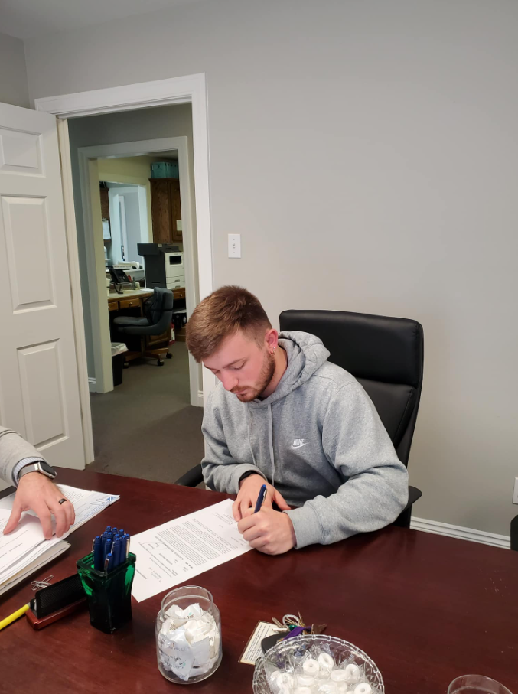
LHC On Your Block: CHDO Feature
Notes:
The LHC Public Affairs Team interviewed one of CHDOs, the Bread of Life Community Development, which is located in Oakdale Louisiana. Our team interviewed the executive director and one of the homeowners that benefitted through one of our programs.

Slide 5
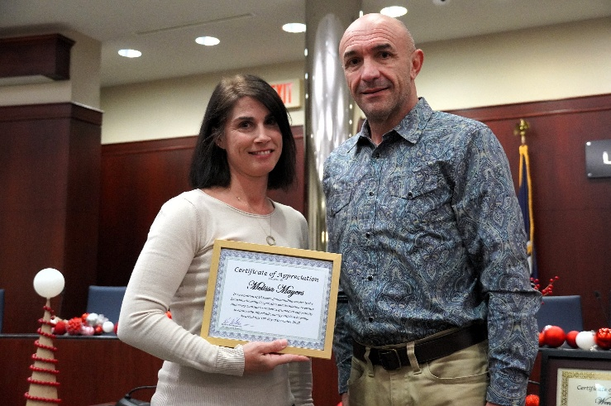
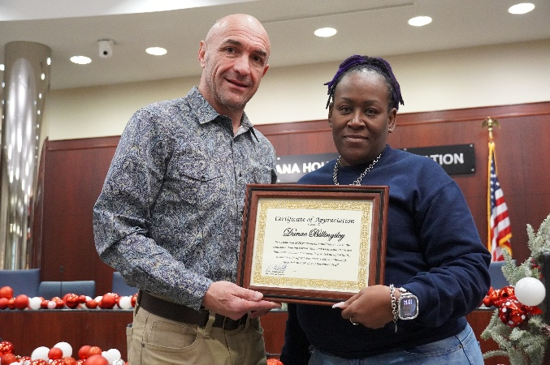
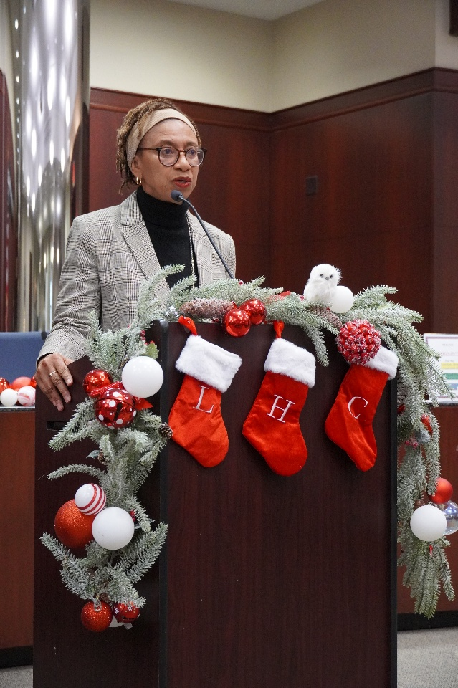
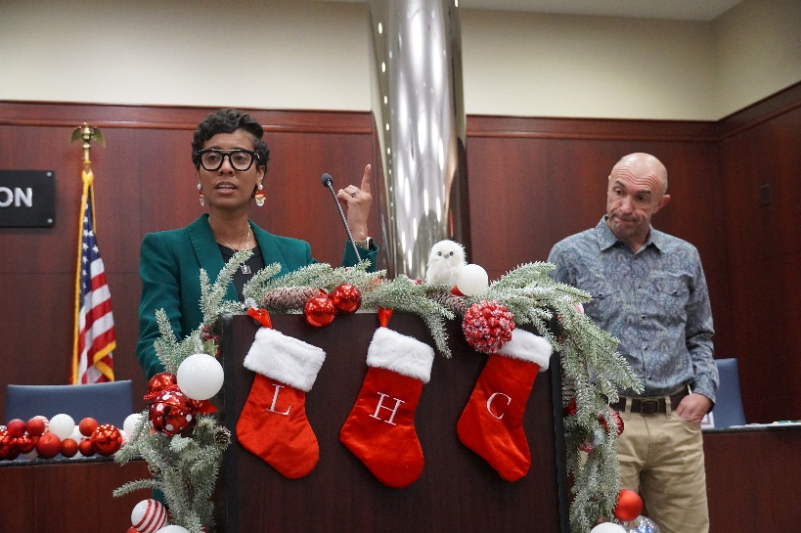
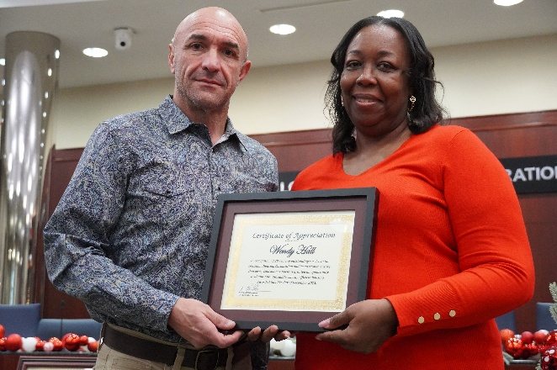
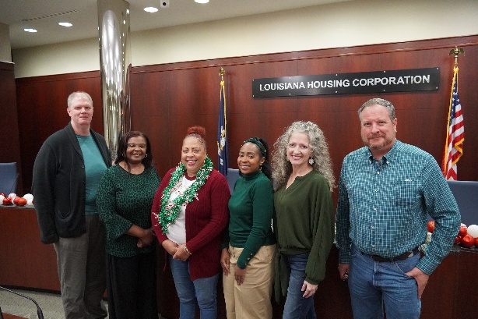
LHC End of the Year Staff Meeting
Notes:
The LHC Executive Team and Staff held their annual end-of-the-year team meeting in December. Service awards were given out to those for their time at LHC.

